Slide 1

AUTONAS
A NEURAL ARCHITECTURE SEARCH–BASED MODEL SELECTION SYSTEM
FOR HEART DISEASE PREDICTION
Guided by:
Dr. Smitha E S
Prof. Janisha A
Submitted by :
Nanditha S
LBT25CSCE03
M2 CSE

Slide 2

TABLE OF CONTENTS
INTRODUCTION
MOTIVATION
LITERATURE REVIEW
RESEARCH GAPS
OBJECTIVE
SYSTEM ARCHITECTURE
METHODOLOGY
TECHNOLOGY USED
IMPLEMENTATION
INTERIM RESULTS
PROJECT PLAN
CONCLUSION
REFERENCES

Slide 3
INTRODUCTION
Heart disease is a major cause of death worldwide, and early detection helps reduce mortality rates.
Coronary Artery Disease (CAD) occurs when heart blood vessels are narrowed or blocked due to plaque buildup, increasing the risk of heart attack.
Traditional diagnosis methods include ECG, blood tests, stress tests, and angiography, which require expert interpretation.
These conventional methods may fail to detect complex patterns in patient data.
Machine learning helps analyze large medical datasets and identify hidden patterns for better diagnosis.
Common algorithms used are Logistic Regression, Decision Tree, Support Vector Machine, Random Forest, and Artificial Neural Networks, but they require manual design and tuning.
Deep learning models can capture complex relationships, but designing the best architecture is difficult and needs expert knowledge.
Neural Architecture Search (NAS) automatically designs optimized neural networks, improving accuracy and performance using datasets like the Cleveland Heart Disease Dataset.

Slide 4
MOTIVATION
Heart disease prediction is an important area in biomedical engineering and artificial intelligence, helping doctors make faster and more reliable decisions.
Traditional diagnosis methods mainly depend on doctor experience, manual interpretation, and basic statistical models.
These traditional approaches may not always provide accurate or consistent results.
Machine learning improves prediction by analyzing data, but it requires manual feature selection and model tuning.
Different machine learning models can produce different results and may not guarantee the best architecture.
Deep learning gives better performance but is difficult to design, as choosing layers, neurons, and activation functions involves trial-and-error and is time-consuming.
Neural Architecture Search (NAS) automatically finds the best neural network structure without manual effort.
NAS offers advantages like higher accuracy, less human effort, better generalization, and is suitable for medical data, making it ideal for heart disease prediction systems.

Slide 5
LITERATURE REVIEW
International Application of a New Probability Algorithm for the Diagnosis of Coronary Artery Disease AUTHOR: R. Detrano et al. Date: 1989 SOURCE: American Journal of Cardiology | ABSTRACT • Early computer-based diagnostic system for CAD • Probability-based algorithm using clinical parameters • Parameters: age, sex, chest pain, BP, cholesterol, ECG, heart rate • Introduced the Cleveland Heart Disease Dataset | ADVANTAGES • Simple and interpretable statistical model • Introduced the standard Cleveland benchmark dataset • Widely reproducible across clinical sites
 | Datasets Used • Cleveland Heart Disease Dataset | DISADVANTAGES • Uses statistical probability only • Cannot learn complex nonlinear feature relationships • Limited predictive accuracy
 | Final Result / Accuracy • Moderate accuracy (~77%) on Cleveland dataset

Slide 6
LITERATURE REVIEW
Heart Disease Prediction Using Machine Learning Algorithms AUTHOR: H. Chen, Y. Zhang, Z. Liu Date: 2019 SOURCE: IEEE Access | ABSTRACT • Proposed a system using Decision Tree, SVM, Naive Bayes, Random Forest • Preprocessing: normalization and feature selection applied • Random Forest achieved best performance due to nonlinear handling • Multiple ML models systematically compared | ADVANTAGES • Multiple ML models benchmarked in one study • Feature selection improves prediction accuracy • Random Forest handles nonlinear relationships well
 | Datasets Used • Cleveland Heart Disease Dataset (UCI) | DISADVANTAGES • Manual selection of parameters and features required • System depends on human expertise for tuning • No automatic model design or NAS used
 | Final Result / Accuracy • ~85% accuracy achieved by Random Forest

Slide 7
LITERATURE REVIEW
Heart Disease Prediction Using Deep Neural Networks AUTHOR: S. Khan, M. Alotaibi Date: 2020 SOURCE: Computers in Biology and Medicine | ABSTRACT • Deep neural network (DNN) applied for heart disease prediction • Multiple hidden layers with nonlinear activation functions • Higher accuracy than traditional ML models • Automatic feature extraction from medical parameters | ADVANTAGES • Learns complex nonlinear patterns automatically • Outperforms traditional machine learning models • No manual feature engineering required
 | Datasets Used • Cleveland Heart Disease Dataset | DISADVANTAGES • Network architecture was manually designed • May not produce the optimal architecture • Requires substantial labeled training data
 | Final Result / Accuracy • ~87% accuracy on Cleveland dataset

Slide 8
LITERATURE REVIEW
Neural Architecture Search with Reinforcement Learning AUTHOR: Barret Zoph, Quoc V. Le Date: 2017 SOURCE: ICLR 2017 | ABSTRACT • Introduced Neural Architecture Search (NAS) using RL • A controller RNN generates and evaluates architectures • Best architecture selected automatically by the system • NAS-designed models outperform manually designed networks | ADVANTAGES • Fully automatic neural network architecture generation • Demonstrated superior performance over manual design • Generalizes to language modeling and image tasks
 | Datasets Used • CIFAR-10 • Penn Treebank | DISADVANTAGES • Extremely high computational cost (thousands of GPU hours) • Not practical for small or resource-limited projects • Primarily validated on CIFAR-10 and language tasks
 | Final Result / Accuracy • ~97.1% accuracy on CIFAR-10

Slide 9
LITERATURE REVIEW
Neural Architecture Search: A Survey AUTHOR: Thomas Elsken, Jan Hendrik Metzen, Frank Hutter Date: 2019 SOURCE: Journal of Machine Learning Research | ABSTRACT • Comprehensive survey covering all major NAS components • Three key components: Search Space, Search Strategy, Performance Evaluation • NAS useful when optimal architecture is unknown • Reviews random, evolutionary, RL, and gradient-based NAS methods | ADVANTAGES • Comprehensive overview of all NAS methods • Identifies best strategies for different problem types • Directly applicable to medical prediction tasks
 | Datasets Used • Various benchmark datasets (CIFAR-10, ImageNet) | DISADVANTAGES • Survey paper only – no new algorithm proposed • NAS methods reviewed are still computationally expensive • Limited focus on healthcare applications
 | Final Result / Accuracy • N/A – Survey paper; summarizes state-of-the-art NAS results

Slide 10
LITERATURE REVIEW
AutoML for Healthcare Applications AUTHOR: J. Liu, H. Li, L. Zhang Date: 2021 SOURCE: IEEE Reviews in Biomedical Engineering | ABSTRACT • Discusses use of AutoML and NAS in healthcare prediction systems • Medical data contains complex nonlinear relationships • Manual model design is difficult for medical data • NAS can automatically generate better-performing neural networks | ADVANTAGES • Removes need for manual model design in healthcare • Handles complex relationships in medical data • Better performance than manually designed models
 | Datasets Used • Various public healthcare and clinical datasets | DISADVANTAGES • High computational overhead for architecture search • Requires large labeled healthcare datasets • Limited real-world clinical deployment demonstrated
 | Final Result / Accuracy • Improved accuracy over manual ML models in healthcare tasks

Slide 11
LITERATURE REVIEW
UCI Machine Learning Repository: Heart Disease Dataset AUTHOR: D. Dua, C. Graff Date: 2019 SOURCE: UCI Machine Learning Repository | ABSTRACT • Standard benchmark dataset for heart disease prediction research • Contains 303 patient records with 14 clinical features • Features: age, sex, chest pain, BP, cholesterol, ECG, heart rate, etc. • Cleveland subset is most widely used in research | ADVANTAGES • Publicly available and freely accessible • Widely used benchmark enabling fair comparison • Contains diverse and clinically relevant features
 | Datasets Used • Cleveland Heart Disease Dataset (303 samples, 14 features) | DISADVANTAGES • Small dataset (303 records) limits deep learning effectiveness • Limited to one hospital population (Cleveland Clinic) • May not generalize to broader global populations
 | Final Result / Accuracy • N/A – Dataset paper; benchmark for heart disease prediction research

Slide 12
LITERATURE REVIEW
Deep Learning AUTHOR: Ian Goodfellow, Yoshua Bengio, Aaron Courville Date: 2016 SOURCE: MIT Press (Textbook) | ABSTRACT • Foundational textbook on deep learning theory and practice • Covers neural networks, backpropagation, and optimization • Explains how deep networks learn complex patterns from data • Provides mathematical foundation for modern AI systems | ADVANTAGES • Comprehensive theoretical reference for deep learning • Covers all major deep learning concepts and techniques • Applicable to medical data prediction problems
 | Datasets Used • Standard benchmarks (MNIST, CIFAR) for illustrative examples | DISADVANTAGES • Theoretical textbook – no specific medical application • No experimental results on healthcare datasets • Does not address NAS or AutoML
 | Final Result / Accuracy • N/A – Textbook; foundational reference for deep learning theory

Slide 13
LITERATURE REVIEW
Deep Residual Learning for Image Recognition AUTHOR: Kaiming He, Xiangyu Zhang, Shaoqing Ren, Jian Sun Date: 2016 SOURCE: CVPR 2016 | ABSTRACT • Introduced residual (skip) connections to train very deep networks • Architecture design strongly determines model performance • Proves better architectures consistently lead to better accuracy • Provides strong motivation and foundation for NAS research | ADVANTAGES • Proves architecture choice is critical for performance • Residual connections enable very deep network training • Strong motivation and evidence supporting need for NAS
 | Datasets Used • ImageNet (1.2M images) • CIFAR-10 | DISADVANTAGES • Manually designed architecture – not automatic • Primarily focused on image recognition, not medical data • Complex to implement and adapt for tabular medical data
 | Final Result / Accuracy • ~96.7% on CIFAR-10; ~3.57% top-5 error on ImageNet

Slide 14
LITERATURE REVIEW
Regularized Evolution for Image Classifier Architecture Search AUTHOR: Esteban Real, Alok Aggarwal, Yanping Huang Date: 2019 SOURCE: AAAI 2019 | ABSTRACT • Proposed evolutionary algorithm for neural architecture search • Automatically generates and evaluates multiple architectures • Tournament selection with regularization prevents premature convergence • Automatic search outperforms manually designed architectures | ADVANTAGES • Fully automated architecture generation using evolution • Outperforms manually designed networks consistently • Scalable evolutionary approach with regularization
 | Datasets Used • CIFAR-10 • ImageNet | DISADVANTAGES • Very high computation cost – requires many GPU hours • Primarily designed for image classification tasks • Difficult to directly apply to small tabular medical datasets
 | Final Result / Accuracy • ~97.6% accuracy on CIFAR-10

Slide 15
LITERATURE REVIEW
Efficient Neural Architecture Search via Parameter Sharing AUTHOR: H. Pham, M. Guan, B. Zoph Date: 2018 SOURCE: ICML 2018 | ABSTRACT • Proposed ENAS: faster NAS via shared parameters across child models • Reduces training cost by orders of magnitude over original NAS • Parameter sharing makes architecture search practical for real use • Controller learns to search using shared weights efficiently | ADVANTAGES • Dramatically faster than original RL-based NAS • Parameter sharing reduces computation significantly • Practical for real-world architecture search tasks
 | Datasets Used • Penn Treebank (NLP) • CIFAR-10 | DISADVANTAGES • Shared parameters may not reflect true individual model performance • Complex implementation of the weight-sharing scheme • Additional memory overhead for shared parameter storage
 | Final Result / Accuracy • ~97.11% accuracy on CIFAR-10 (2.89% error rate)

Slide 16
LITERATURE REVIEW
SNAS: Stochastic Neural Architecture Search AUTHOR: S. Xie, H. Zheng, C. Liu Date: 2019 SOURCE: ICLR 2019 | ABSTRACT • Introduced gradient-based differentiable NAS using stochastic sampling • Faster and more efficient than reinforcement learning NAS • Reduces computation cost significantly over RL-based methods • Architecture parameters optimized jointly with network weights | ADVANTAGES • Gradient-based search is much faster than RL or evolutionary NAS • Efficient use of computation through differentiable relaxation • End-to-end differentiable architecture optimization
 | Datasets Used • CIFAR-10 • ImageNet | DISADVANTAGES • May get stuck in local optima during optimization • Sensitive to hyperparameter settings and learning rates • Potential architecture collapse during training
 | Final Result / Accuracy • ~97.02% accuracy on CIFAR-10 (2.98% error)

Slide 17
LITERATURE REVIEW
Deep Patient: An Unsupervised Representation for Predicting Patient Outcomes AUTHOR: R. Miotto, L. Li, B. Kidd Date: 2016 SOURCE: Scientific Reports (Nature) | ABSTRACT • Applied deep learning to Electronic Health Records (EHR) • Unsupervised deep feature learning for patient outcome prediction • Deep networks learn complex relationships in medical records • Learned representations generalize across diverse diseases | ADVANTAGES • Learns rich patient representations from unlabeled medical data • Handles large and diverse electronic health records • Generalizes across multiple disease prediction tasks
 | Datasets Used • Electronic Health Records – ~700,000 patients (Mount Sinai Hospital) | DISADVANTAGES • Requires access to large hospital EHR databases • Black-box model limits clinical interpretation and trust • Difficult to explain predictions to medical practitioners
 | Final Result / Accuracy • AUC ~0.773 on disease prediction; outperforms baseline models

Slide 18
LITERATURE REVIEW
Deep Learning in Electronic Health Records AUTHOR: B. Shickel, P. Tighe, A. Bihorac Date: 2018 SOURCE: IEEE Journal of Biomedical and Health Informatics | ABSTRACT • Comprehensive review of deep learning for clinical prediction from EHR • Neural networks handle large and complex medical datasets effectively • Applications: mortality prediction, disease classification, clinical NLP • Identifies best DL architectures suited for healthcare tasks | ADVANTAGES • Handles large-scale clinical datasets efficiently • High accuracy across multiple clinical prediction tasks • Automatic feature extraction removes manual engineering
 | Datasets Used • MIMIC-III ICU Database • Various EHR datasets | DISADVANTAGES • Requires very large amounts of labeled medical data • Interpretability challenges hinder clinical adoption • High computational and infrastructure requirements
 | Final Result / Accuracy • ~85-90% accuracy on mortality and disease prediction tasks

Slide 19
LITERATURE REVIEW
Cardiologist-Level Arrhythmia Detection with Deep Neural Networks AUTHOR: P. Rajpurkar, J. Hannun, M. Haghpanahi Date: 2017 SOURCE: arXiv (Stanford University) | ABSTRACT • CNN trained on 91,232 ECG recordings for arrhythmia detection • Achieved accuracy exceeding the average cardiologist benchmark • End-to-end learning directly from raw 1D ECG signal data • No manual feature engineering required – fully automated pipeline | ADVANTAGES • Achieves cardiologist-level accuracy in medical diagnosis • End-to-end learning from raw ECG – no manual feature extraction • Proves deep neural networks are highly suitable for healthcare
 | Datasets Used • 91,232 single-lead ECG recordings (Stanford Health Care) | DISADVANTAGES • Requires very large labeled ECG dataset for training • Deep network explainability is limited in clinical settings • Specific to arrhythmia – does not generalize to other conditions
 | Final Result / Accuracy • F1 score 0.837 – exceeds average cardiologist benchmark (0.780)

Slide 20
RESEARCH GAPS
From previous studies, the following problems are identified:
Statistical models have low accuracy
Machine learning requires manual tuning
Deep learning architecture design is manual
Different architectures give different results
No guarantee of best model
Limited use of NAS in heart disease prediction
Need for automatic model generation
Need for higher accuracy medical prediction
Therefore, NAS-based heart disease prediction is required.

Slide 21

OBJECTIVE
Study existing heart disease prediction methods
Use Cleveland dataset
Implement ML models
Implement deep learning model
Apply Neural Architecture Search
Generate automatic neural network
Compare ML / DL / NAS
Improve accuracy
Develop automated system
Provide reliable prediction

Slide 22
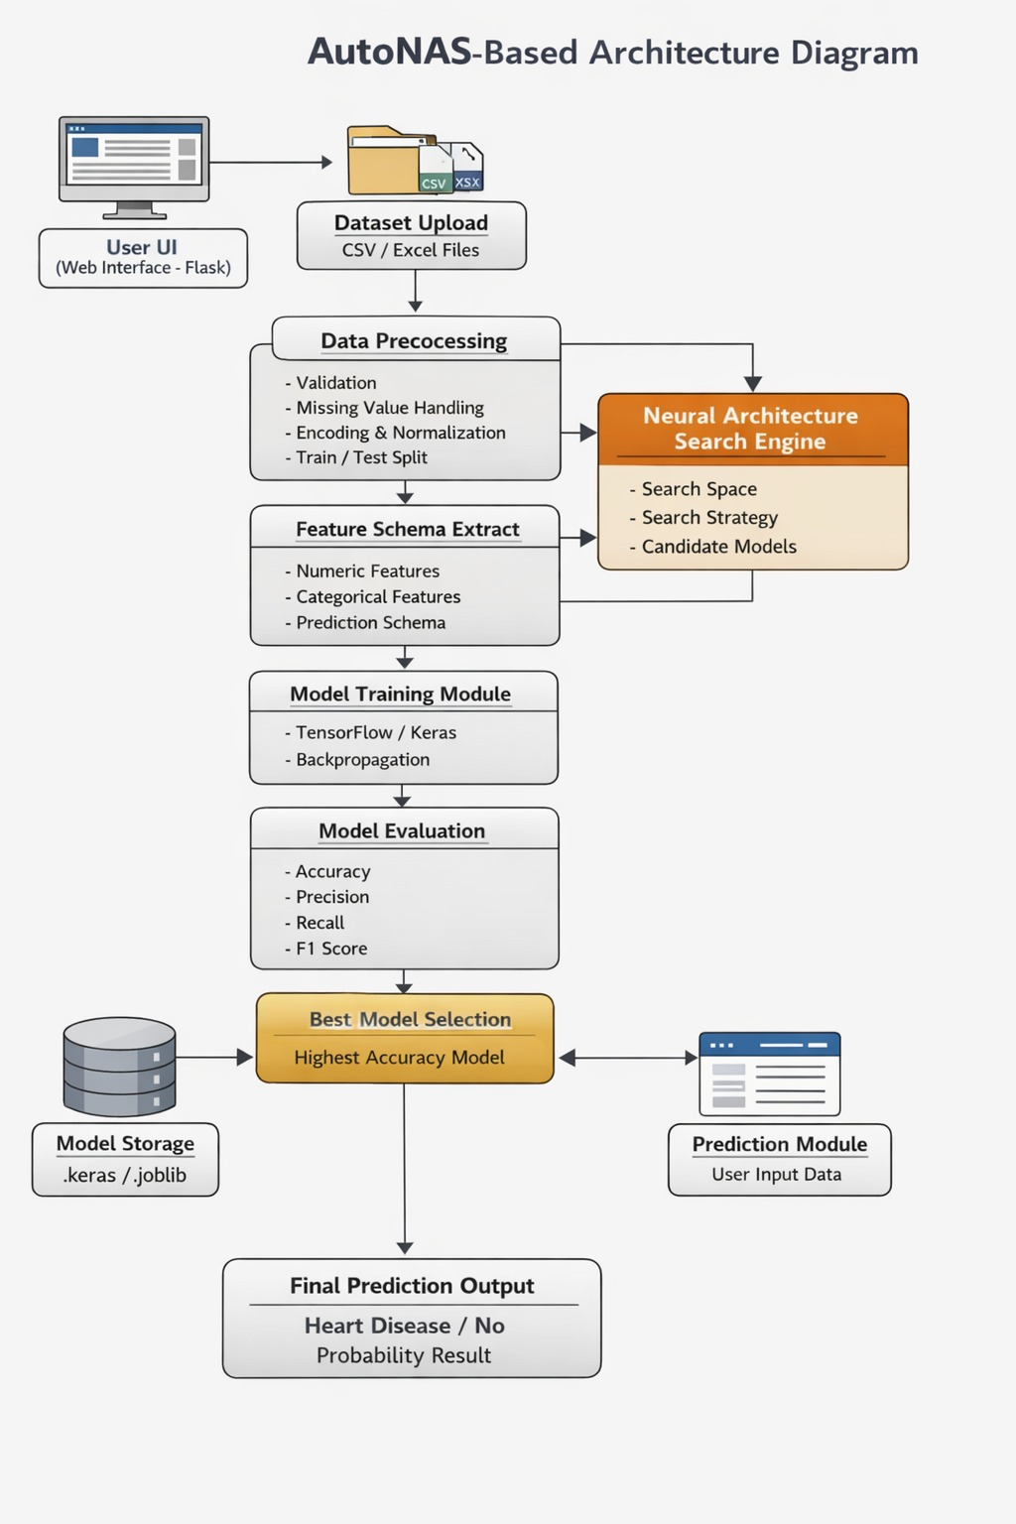
SYSTEM ARCHITECTURE

Slide 23
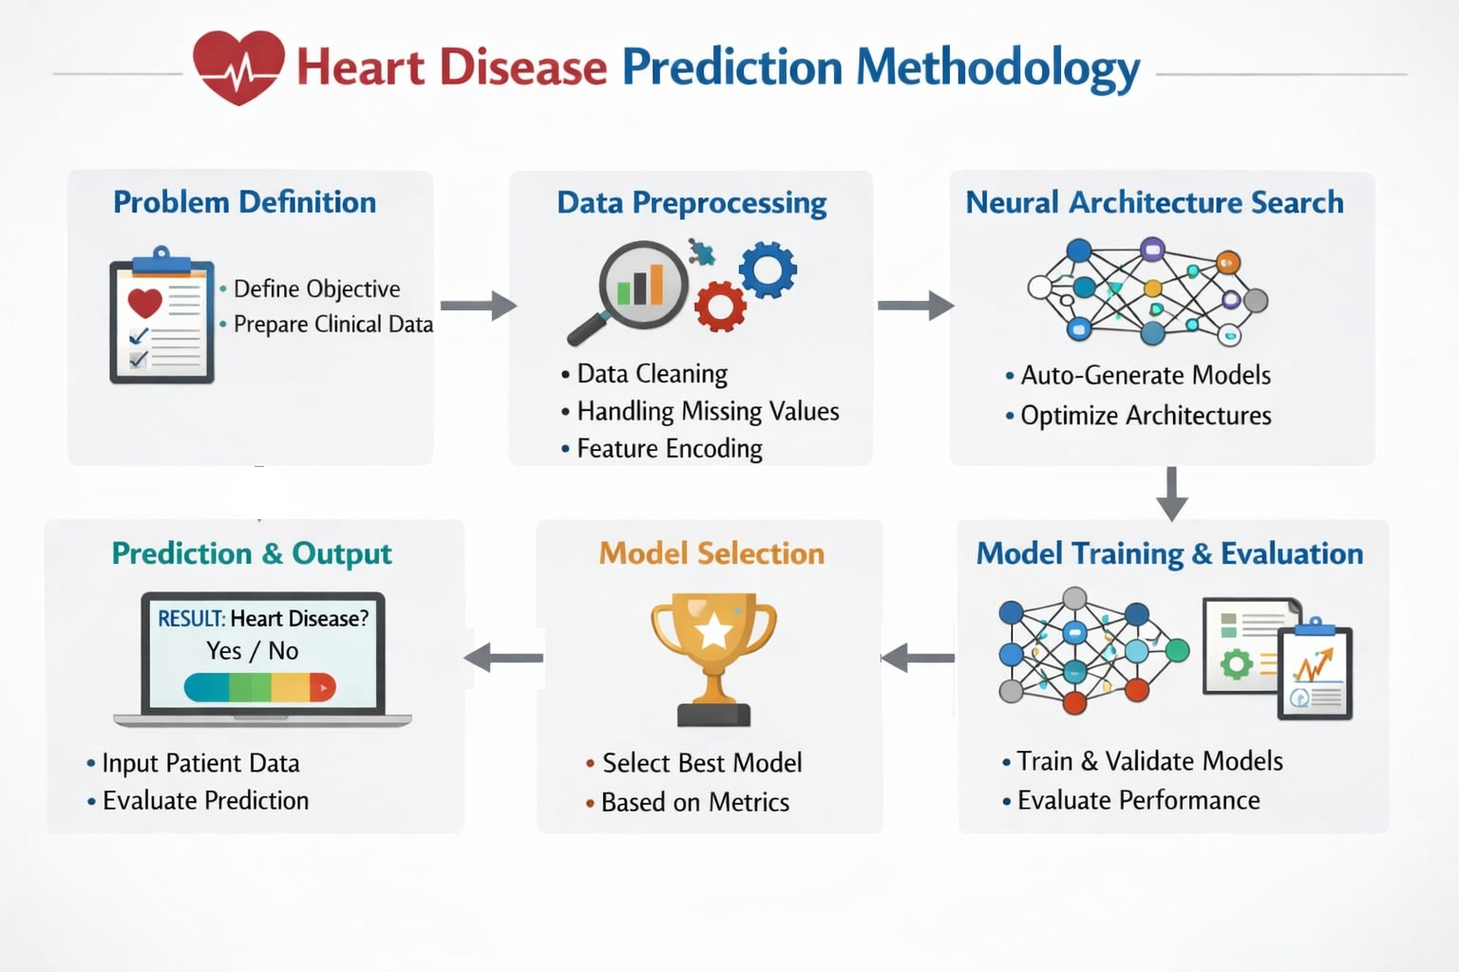
METHODOLOGY

Slide 24
METHODOLOGY
The proposed system focuses on developing an automated heart disease prediction model.
It uses Neural Architecture Search (NAS) to design the model.
The system automatically preprocesses medical data for better accuracy.
It generates multiple neural network architectures instead of using a single fixed model.
Each generated model is trained using the given dataset.
The performance of all models is evaluated and compared.
The best-performing model is selected for final prediction.
The complete process includes problem definition, data preprocessing, architecture search, model training, evaluation, and prediction.

Slide 25
METHODOLOGY
Problem Definition
The main goal of this project is to build a machine learning system to predict heart disease.
The system uses patient medical data to make predictions.
This is a supervised learning problem where the model learns from labeled data.
The model predicts whether a patient has heart disease or not.
Input features include:
Age of the patient
Sex
Type of chest pain
Resting blood pressure
Cholesterol level
Fasting blood sugar
ECG results
Maximum heart rate achieved
Exercise-induced angina
Oldpeak value
Slope of ST segment
Number of major Vessels
Thalassemia

Slide 26
METHODOLOGY
Output:
0 means no heart disease.
1 means heart disease is present.
Evaluation metrics used:
Accuracy checks overall correctness.
Precision measures correct positive predictions.
Recall measures how many actual positives are foundF1-score balances. precision and recall.
Confusion matrix shows prediction results clearly.

Slide 27
METHODOLOGY
2. Data Collection and Preprocessing
The dataset can be collected from hospitals or public sources like Cleveland dataset.
Before training, data must be cleaned and prepared properly.
Data Validation
The dataset is checked for errors and correctness.
Missing values are identified.
Incorrect data types are corrected.
Empty columns are removed.
Target labels are verified.
Invalid data is removed to improve accuracy.
Handling Missing Values
Missing numerical values are replaced with mean or median.
Missing categorical values are replaced with mode.
Rows with too many missing values are removed.
This step ensures complete and clean data.

Slide 28
METHODOLOGY
Feature Encoding
Some data values are categorical and need conversion.
Label encoding assigns numbers to categories.
One-hot encoding creates binary columns.
This helps the neural network understand the data.
Data Normalization
Features may have different ranges.
Large values can affect learning negatively.
Min–Max scaling brings values between 0 and 1.Standardization scales data around mean.
This improves model performance and training speed.
Train–Test Split
Data is divided into three parts.
Training set is used to train the model.
Validation set is used to compare models.
Testing set is used for final evaluation.

Slide 29
METHODOLOGY
3.Neural Architecture Search (NAS)
NAS automatically finds the best neural network design.
It removes the need for manual model design.
It has three main components.
Search Space
Search space includes all possible model designs.
It defines different combinations of parameters.
Parameters include:
Number of hidden layers
Number of neurons
Activation functions
Dropout layers
Optimizer type
Learning Rate

Slide 30
METHODOLOGY
Search Strategy
Search strategy decides how models are generated.
It explores different architectures.
Methods include:
Random search
Evolutionary algorithms
Reinforcement learning
Gradient-based methods
Candidate Model Generation
Multiple models are created automatically.
Each model has a different structure.
All models are trained using training data.
Models are evaluated using validation data.

Slide 31
METHODOLOGY
4. Model Training and Evaluation
Each generated model is trained on the dataset.
The model learns by adjusting weights using backpropagation.
Training settings include:
Loss function is binary cross-entropy
Optimizer can be Adam or SGD
Activation functions include ReLU, Sigmoid, and Tanh
Training runs for multiple epochs
After training, models are evaluated.
Performance is measured using accuracy, precision, recall, and F1-score.
Results are stored for comparison.

Slide 32
METHODOLOGY
5. Model Selection
The best model is selected after evaluation.
Selection is based on performance metrics.
Criteria include:
Highest validation accuracy
Lowest loss
Best F1-score
This model is considered the optimal architecture.
It is used for future predictions.

Slide 33
METHODOLOGY
6. System Interface
The system provides a simple user interface.
Users can upload datasets.
Users can start architecture search.
Models are trained automatically.
Results are displayed clearly.
Users can make predictions easily.
No deep technical knowledge is required.

Slide 34
METHODOLOGY
7. Prediction Process
The final model is used to predict new cases.
Steps include:
User enters patient data
Data is preprocessed
Trained model is applied
Prediction is generated
Output:
Shows whether disease is present or not
Provides probability value
This helps in early detection of heart disease

Slide 35
TECHNOLOGY USED
SOFTWARE REQUIREMENTS:
Programming & Development
Python – Core programming language
TensorFlow / Keras – Deep learning framework
Evolutionary Algorithm – Architecture optimization
2. Web Development
Flask – Backend web framework
HTML, CSS, JavaScript – Frontend interface
Server-Sent Events (SSE) – Real-time updates
3. Dataset & Processing
Heart Disease Dataset (CSV format)
NumPy, Pandas – Data handling
Scikit-learn – Preprocessing & train-test split
HARDWARE REQUIREMENTS:
Processor: i3 or higher
RAM: Minimum 8 GB
Storage: At least 512 MB free space
GPU: Optional (for faster training)
Display: 1366×768 resolution or higher

Slide 36
IMPLEMENTATION
1. Project Setup & Technology Stack
• The system is built in Python using Flask as the web backend.
• TensorFlow and Keras are used to build and train neural network models.
• scikit-learn handles all preprocessing: scaling, encoding, and imputation.
• The frontend uses Bootstrap 5 and Chart.js for a live training dashboard.
• Trained models are saved as .keras files; the pipeline is saved with Joblib.
• app.py handles routing; nas_engine.py runs NAS; data_pipeline.py preps data.

Slide 37
IMPLEMENTATION
2. Data Preprocessing
• The user uploads a CSV or Excel file via the web UI.
• The last column is automatically selected as the prediction target.
• The system detects classification vs regression from the number of unique values.
• Missing values are filled with median (numeric) or mode (categorical).
• Numeric features are normalized with StandardScaler for stable training.
• Data is split into train 60% / validation 20% / test 20% sets.

Slide 38
IMPLEMENTATION
3. NAS Search Space
• The system searches over fully connected (Dense) neural network architectures.
• Each candidate has between 1 and 4 hidden layers.
• Neurons per layer are sampled from the set: 16, 32, 64, or 128.
• Activation functions (ReLU or Tanh) are randomly assigned per layer.
• Output layer uses Softmax for classification or Linear for regression.
• Architectures exceeding 1 million parameters are automatically skipped.

Slide 39
IMPLEMENTATION
4. NAS Search Strategies
• Random Search trains N independent randomly generated architectures.
• Evolutionary Search runs a genetic algorithm over 2-3 generations.
• In each generation, the bottom 50% of architectures are removed.
• Surviving architectures are mutated: add layer, remove layer, or change units.
• Progressive Search grows from 1 layer, adding depth only when accuracy improves.
• The best model is selected automatically by highest validation performance.

Slide 40
IMPLEMENTATION
5. Flask Web Application
• GET / serves the training UI; POST /upload starts the NAS run.
• Training runs in a background thread to keep the app responsive.
• GET /stream pushes live training events to the browser via SSE.
• POST /predict preprocesses user input and runs inference on the best model.
• GET /download_best lets the user save the best .keras model file.
• A 409 error is returned if a NAS run is already in progress.

Slide 41
IMPLEMENTATION
6. Real-Time Training Visualization
• A custom StreamCallback sends Keras training events to an SSE queue.
• Events include per-batch loss, weight norms, epoch results, and run status.
• A thread-safe queue connects the training thread to the /stream endpoint.
• The browser receives events and updates Chart.js graphs without refreshing.
• Per-layer kernel weight norms are visualized as bar charts per candidate.
• A done event is sent with the best model summary when training finishes.

Slide 42
IMPLEMENTATION
7. Model Selection & Prediction
• All candidates are evaluated on a held-out test set after training.
• The best model is selected by highest validation accuracy (or lowest MSE).
• The best .keras model and sklearn pipeline are saved to the uploads folder.
• A training_report.json is exported with full results for all candidates.
• The prediction form is dynamically generated from the dataset feature schema.
• The best model is cached in memory to avoid repeated disk reads.

Slide 43
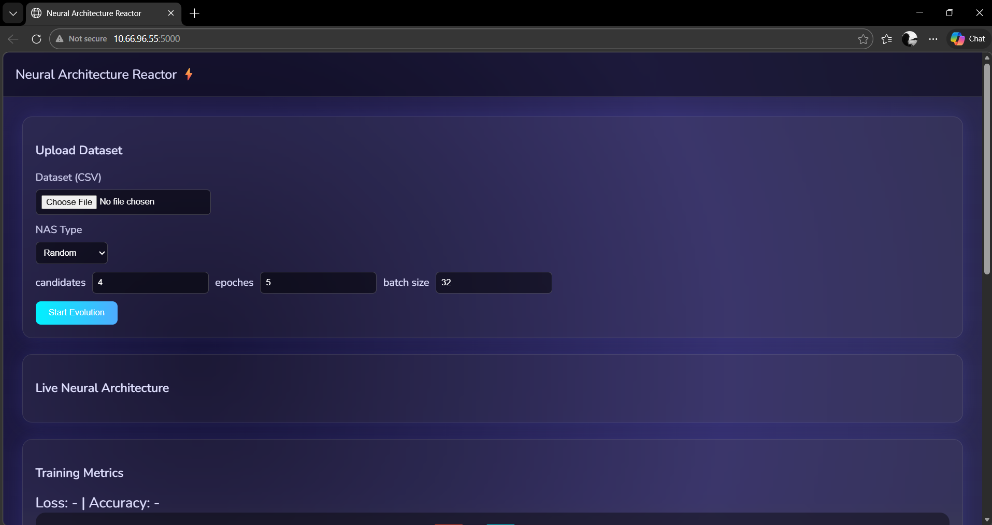
INTERIM RESULTS

Slide 44
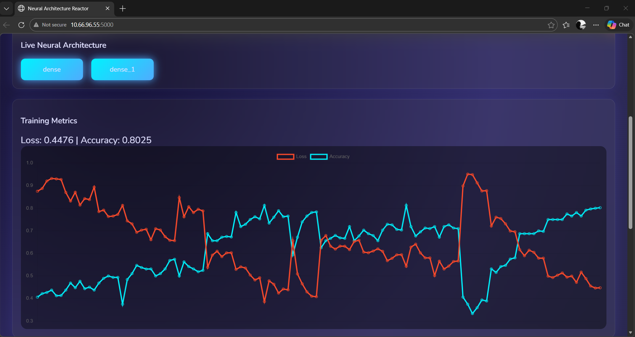
INTERIM RESULTS

Slide 45
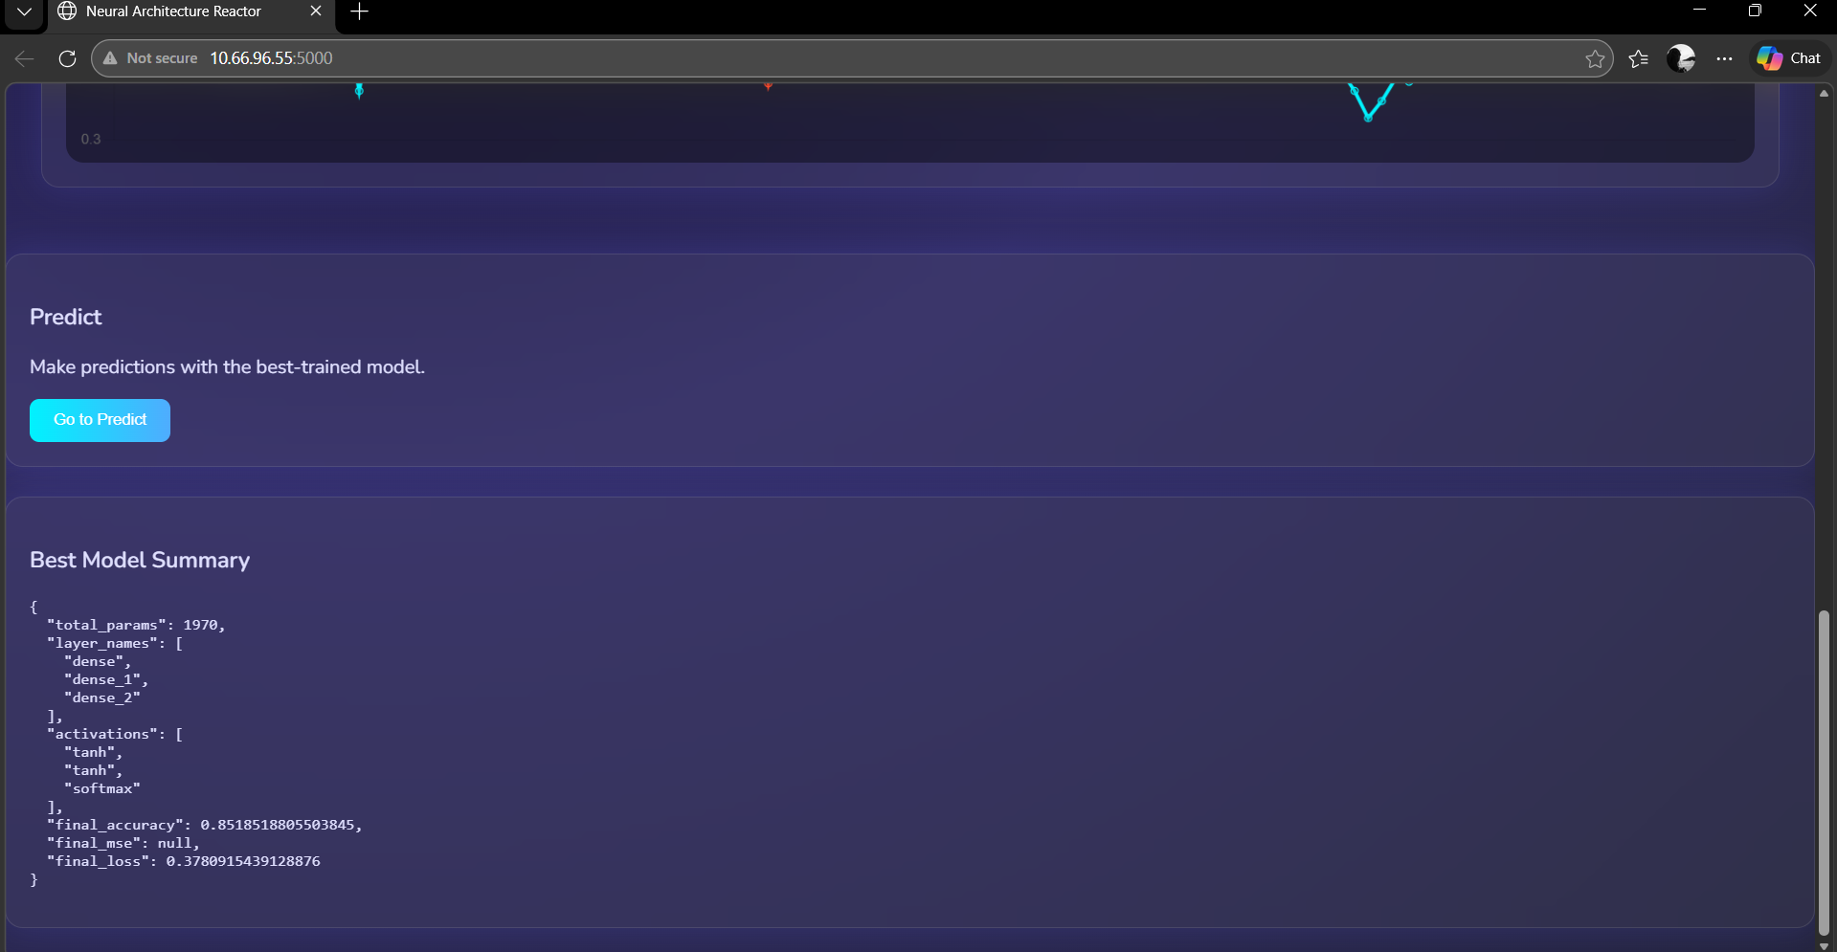
INTERIM RESULTS

Slide 46

PROJECT TIMELINE

Slide 47
CONCLUSION
Heart disease is one of the leading causes of death worldwide, making early detection essential.
Manual diagnosis based only on clinical observation can sometimes be complex and time-consuming.
This project presents an AI-based heart disease prediction system using an Evolutionary Neural Architecture Search (NAS) approach.
The proposed system automatically finds the best-performing neural network architecture for improved prediction accuracy.
The system is efficient, scalable, and user-friendly, making it suitable for real-world healthcare applications.
It supports early diagnosis, assists medical professionals, and contributes to improved patient outcomes.

Slide 48
REFERENCES
Efficient Neural Architecture Search via Parameter Sharing H. Pham, M. Guan, B. Zoph, Q. Le, and J. Dean, “Efficient Neural Architecture Search via Parameter Sharing,” Proc. ICML, 2018.
Auto-Keras: An Efficient Neural Architecture Search System H. Jin, Q. Song, and X. Hu, “Auto-Keras: An Efficient Neural Architecture Search System,” Proc. KDD, 2019.
AutoML: A Survey of the State-of-the-ArtX. He, K. Zhao, and X. Chu, “AutoML: A Survey of the State-of-the-Art,” Knowledge-Based Systems, 2021.
Hybrid Machine Learning Approach for Accurate Heart Disease Prediction S. Ahmed and A. Husien, “Hybrid Machine Learning Approach for Accurate Heart Disease Prediction,” 2024.
Comparative Study of Machine Learning Algorithms for Heart Disease Prediction Rupika et al., “Comparative Study of Machine Learning Algorithms for Heart Disease Prediction,” 2025.
A Survey on Machine Learning Techniques in Health Care IndustryG. Kumar et al., “A Survey on Machine Learning Techniques in Health Care Industry,” 2016.
Heart Disease Prediction Using Data Mining TechniquesH. B. F. David and S. Antony Bell, “Heart Disease Prediction Using Data Mining Techniques,” 2018.

Slide 49
REFERENCES
International Application of a New Probability Algorithm for CAD Diagnosis R. Detrano et al., “International Application of a New Probability Algorithm for the Diagnosis of Coronary Artery Disease,” Am. J. Cardiology, 1989.
Neural Architecture Search using Attention Enhanced Evaluation Y. Li et al., “Neural Architecture Search using Attention Enhanced Precise Path Evaluation and Efficient Forward Evolution,” 2025.
Neural Architecture Search: A Contemporary Literature Review for Computer Vision M. Poyser and T. Breckon, “Neural Architecture Search: A Contemporary Literature Review for Computer Vision Applications,” 2023.
Neural Architecture Search: A SurveyT. Elsken, J. H. Metzen, and F. Hutter, “Neural Architecture Search: A Survey,” JMLR, 2019.
Neural Architecture Search with Reinforcement Learning B. Zoph and Q. V. Le, “Neural Architecture Search with Reinforcement Learning,” ICLR, 2017.
Cardiologist-Level Arrhythmia Detection with CNNP. Rajpurkar et al., “Cardiologist-Level Arrhythmia Detection with Convolutional Neural Networks,” Nature Medicine, 2017.
Neural Architecture Search Concepts and Advances Compilation T. Elsken et al., “Neural Architecture Search: Concepts, Advances, and Applications,” Springer, 2019.

Slide 50

THANK YOU

